Slide 1
Simulation of kTOM subject under coordination paradigm
Aim of the simulation:
With our payoff matrix and number of trials,
What are the expected range of parameters( phi, thetha)

Slide 2
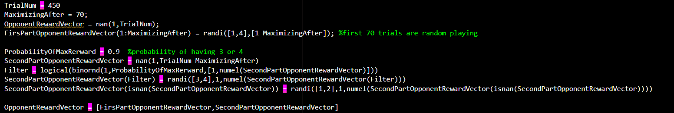
Method: Simulating a subject that starts coordinating after 70 trials
From trials 1 to 70, choices are a random selection from values 1 to 4 with equal probabilities of selection.
Then from trial 71 to end, probability of coordinating ( selecting 3 or 4) is 0.9

Slide 3
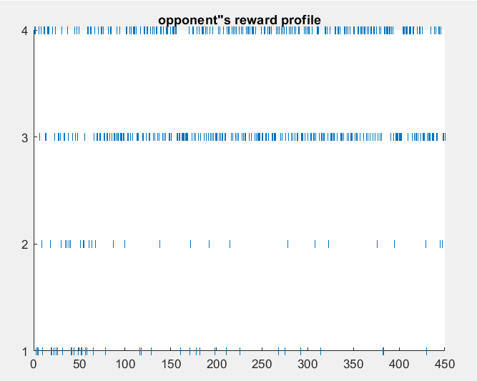
Sanity check:

Slide 4
Method: Should the choice vector be binomial?
There is an option in VBA toolbox for TOM fitting to determine ‘’choice vector’’ data type. For example:
options.binomial = 1; % inform VBA about binomial data
To see which data type give us a better fitting, one time I ran the toolbox with binary choice vector: 1 = preferred color 0 = non preferred color and ofcourse the payoff matric is a vector from 1:4
Another time I determined choice vector to be non binary. Each choice shows the feedback ( from 1 to 4)

Slide 5
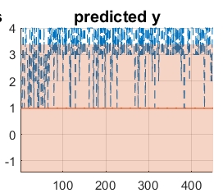
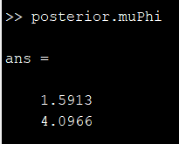
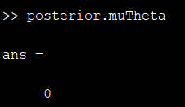
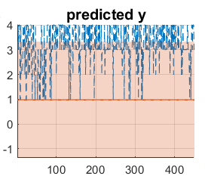
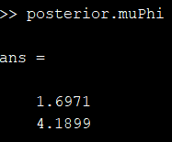
Results: Parameters and K level Subject with coordinating after 70 trials, (Non binary choice vector)
K = 1
K = 0

Slide 6
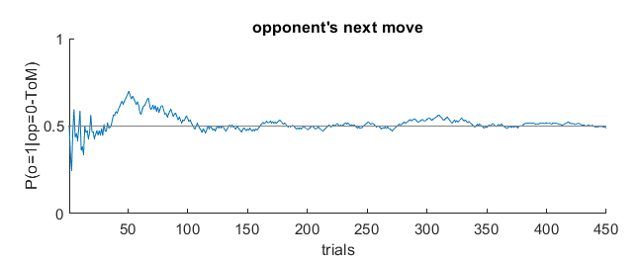
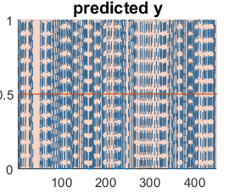
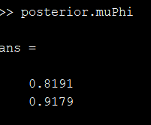
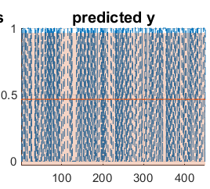
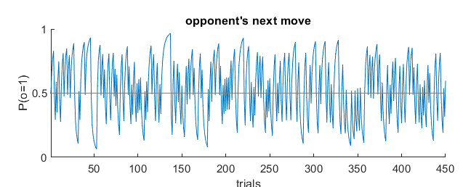
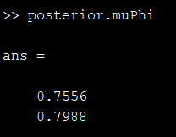
Results: Parameters and K level Subject with coordinating after 70 trials, (Binary choice vector)
K = 1
K = 0

Slide 7
Conclusion
When I change the learning time from 70 to 300,Phi parameter only increases 0.1 in K = 0, Theta remains 0
With K = 1, by increasing the learning time, parameter doesn’t change

